Slide 1
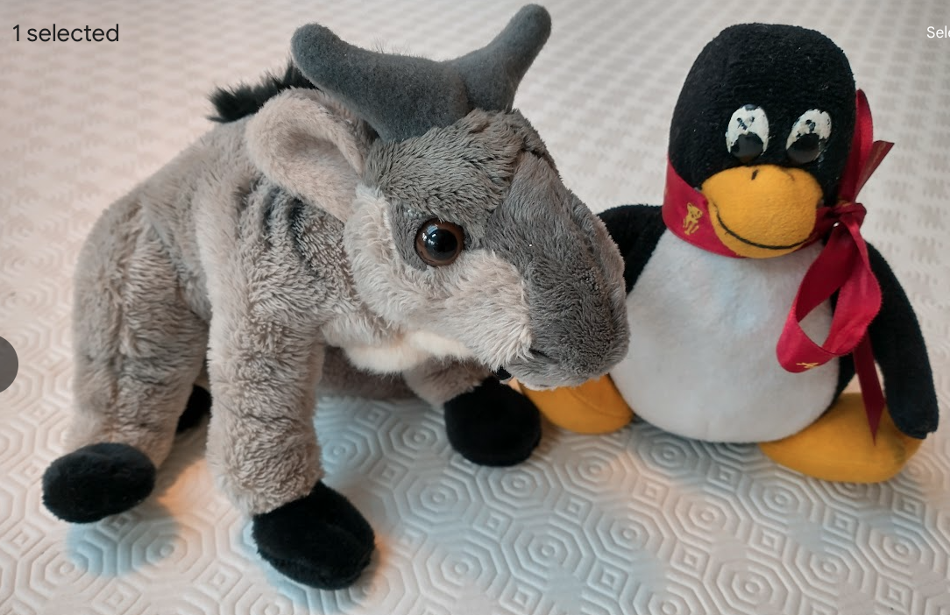
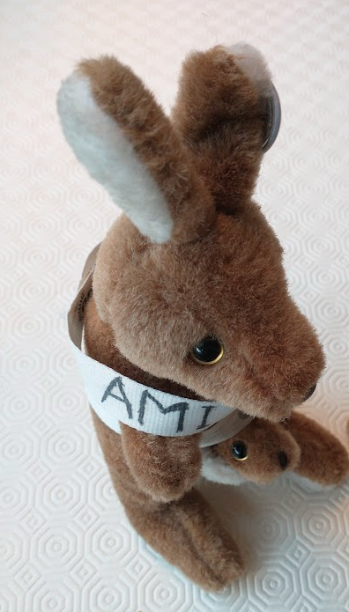
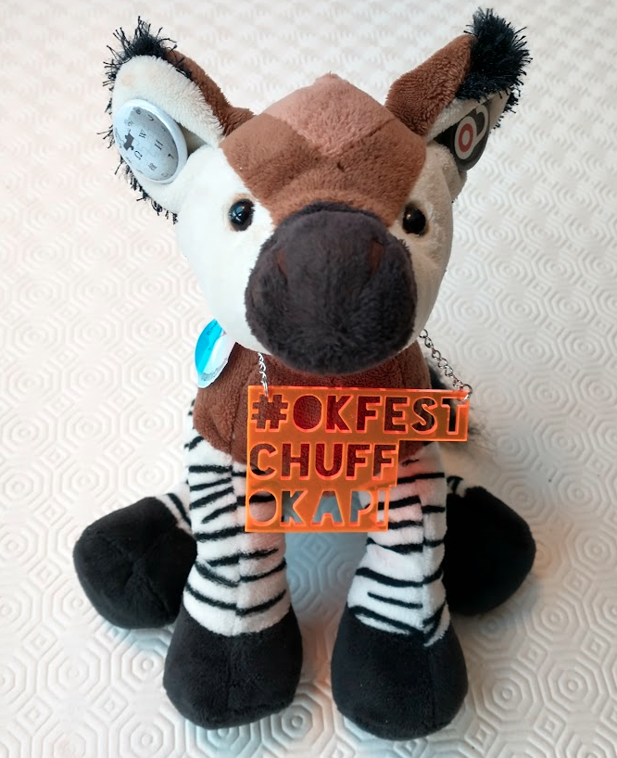
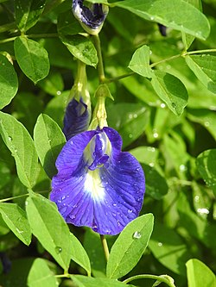




semanticClimate & CODATA/OT-ViRaRe Research assessment & frictionless science
Peter Murray-Rust
University of Cambridge semanticClimate
Peter.murray.rust@googlemail.com
NIPGR team
Volunteers
TIB Germany
BRIC-NIPGR, New Delhi IN, 2026-01-28
https://semanticclimate.github.io/p/en/posts/resources/
We’ll guide you through the presentation
Free and Open Source (F/OSS)
And show how to use our tools
CHUFF the OKF Okapi
AMI, semanticClimate

Slide 2
CODATA asks us to assess research from major institutions!
Humans can’t manage to assess
research 100%
THERE’S TOO MUCH!!
LLMs aren’t 100% reliable! Particularly bad on numbers, dates and names
We need
humans working with machines
Semantics, ontologies frameworks
So: OT-ViRaRe

Slide 3
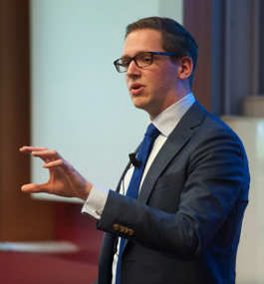
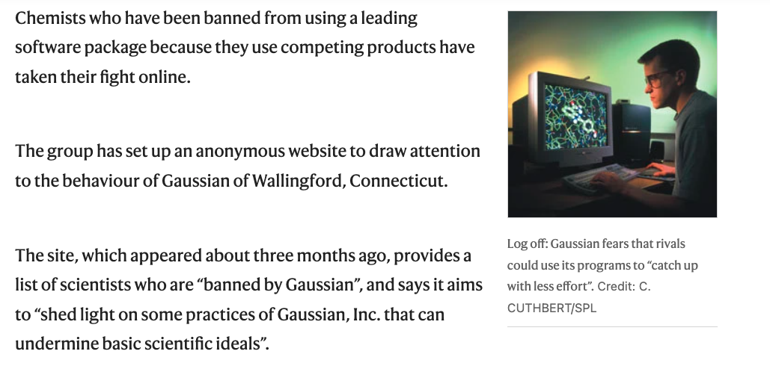

RESTRICTIVE PRACTICE KILLS AUTOMATION!
Elsevier stopped me doing my research
Chris Hartgerink
"Elsevier stopped me doing my research" http://onsnetwork.org/chartgerink/2015/11/16/elsevier-stopped-me-doing-my-research/ … #opencon #TDM
http://bannedbygaussian.org/
https://www.nature.com/articles/429231a

Slide 4
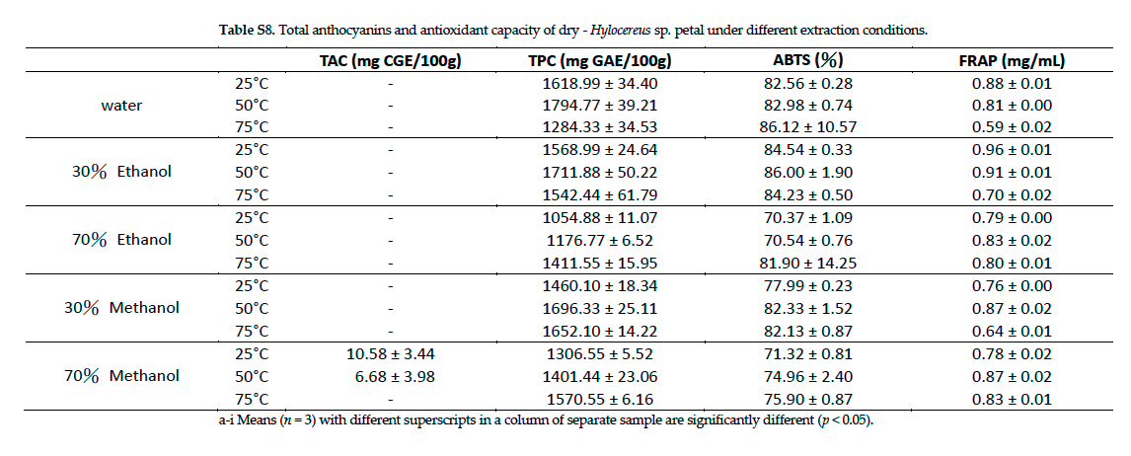
FRICTION KILLS AUTOMATION!
I spend so much time on corrections, retyping, validating
PDF KILLS SCIENTIFIC DATA.
And Tables have to be retyped
Open Knowledge Foundation
Frictionless Data can solve that

Slide 5
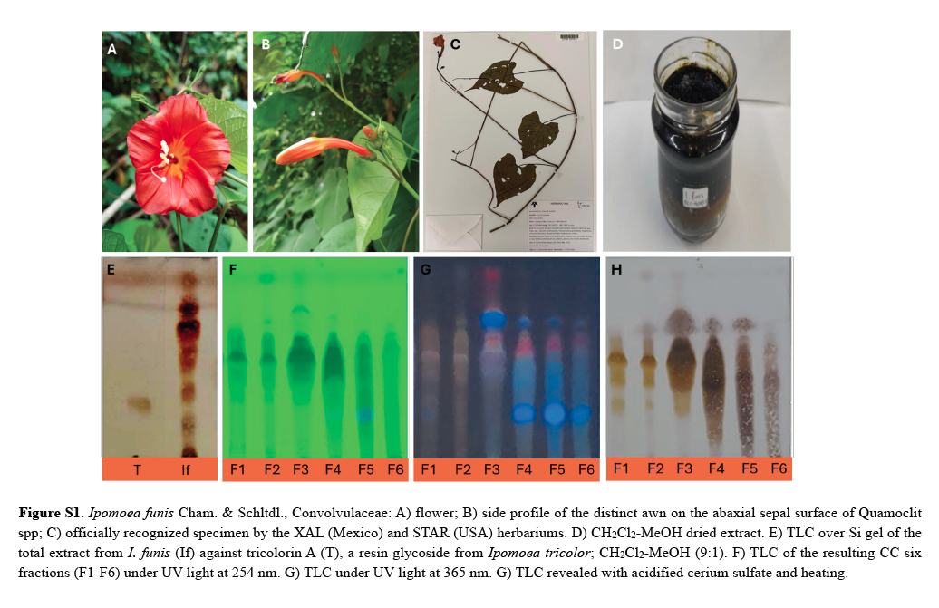
FRICTION KILLS AUTOMATION!
Why can’t authors make semantic figures with captions
Because publishers insist on page limits, impact factors, self interest

Slide 6
Requirements for assessment
Have frictionless access to all material and its context …
We must:
.. which must have semantic structure …
…of computable components
with unique community IDs
FRICTIONLESS DOCUMENTS!!!
Data, Text, Images, and semantic objects
With a collaborative community…

Slide 7
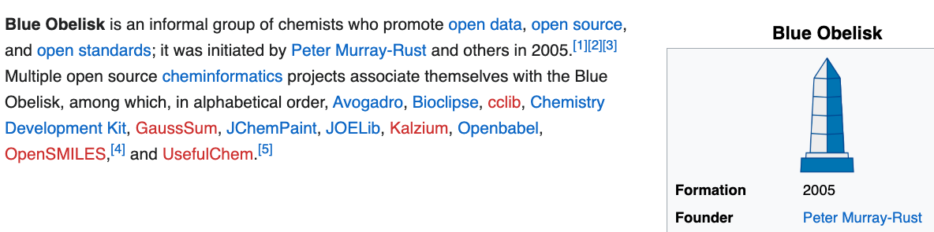
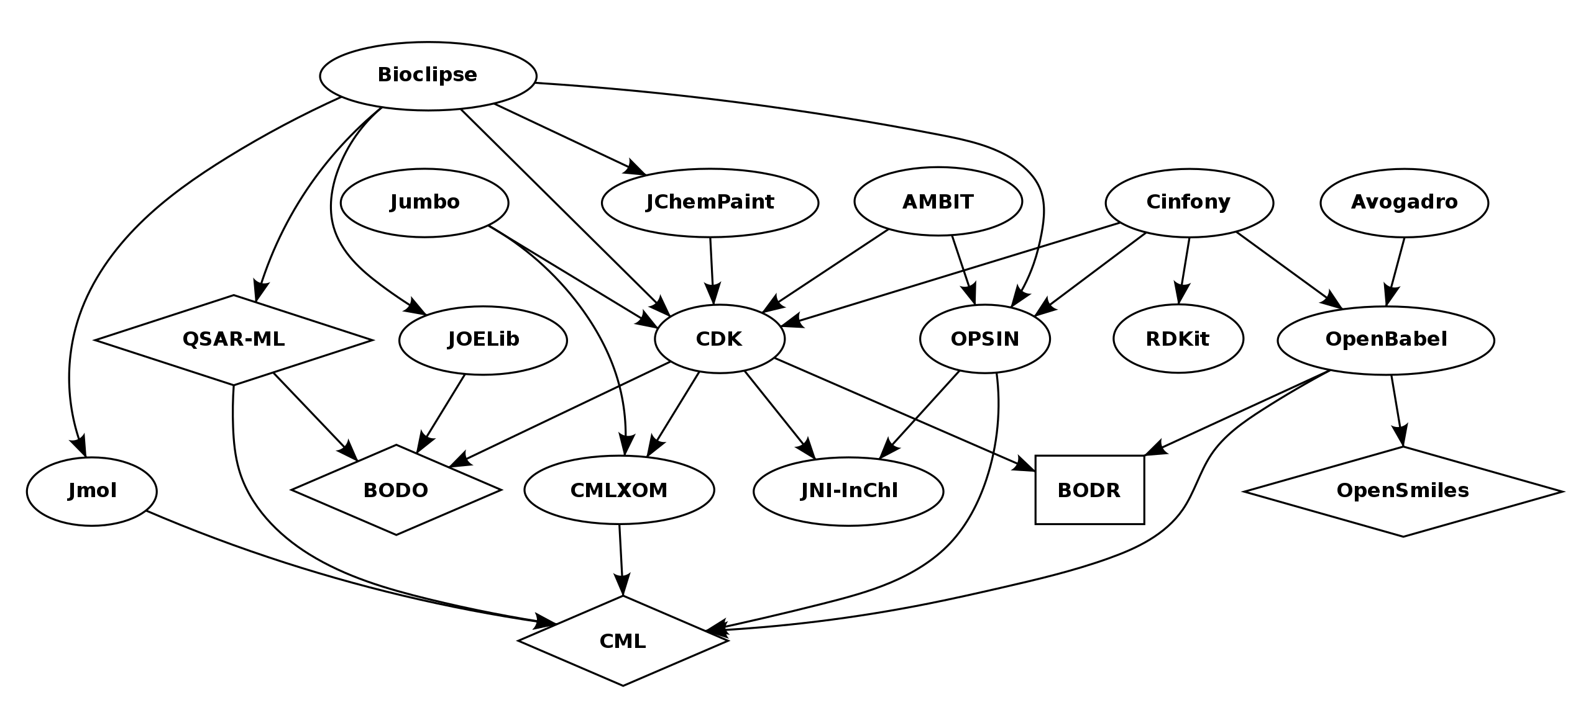
ca 2017

Slide 8
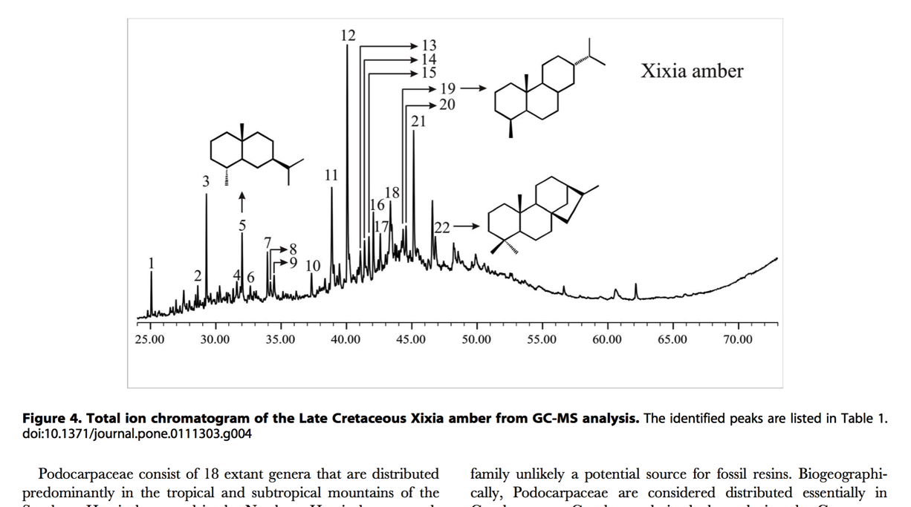
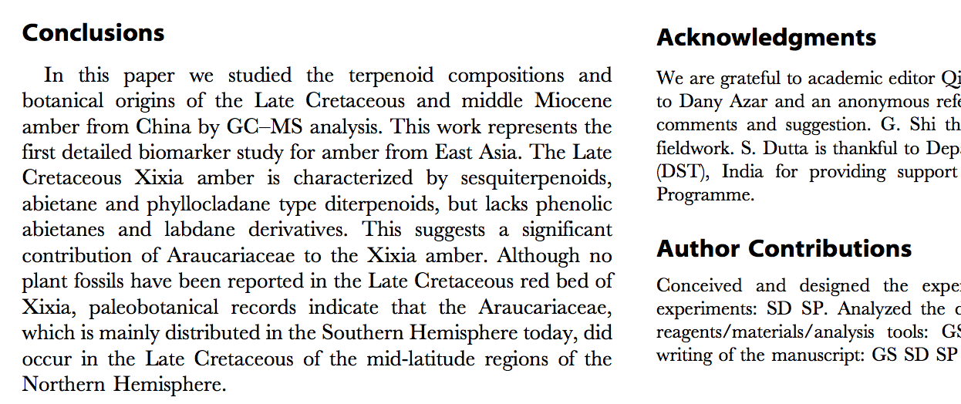
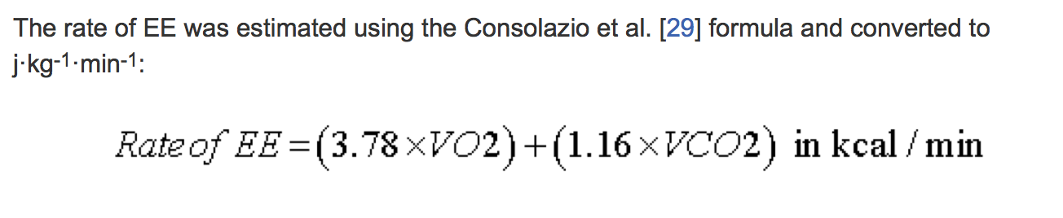
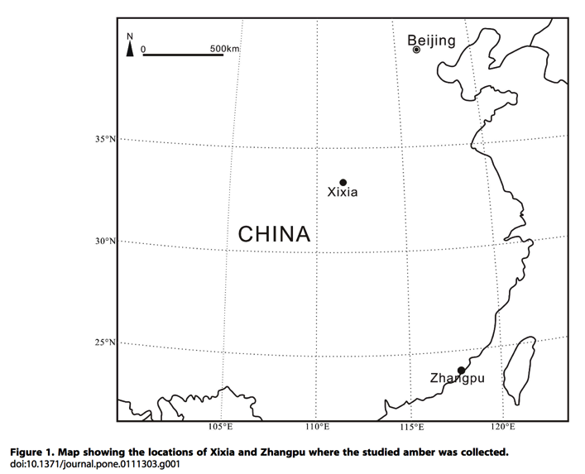
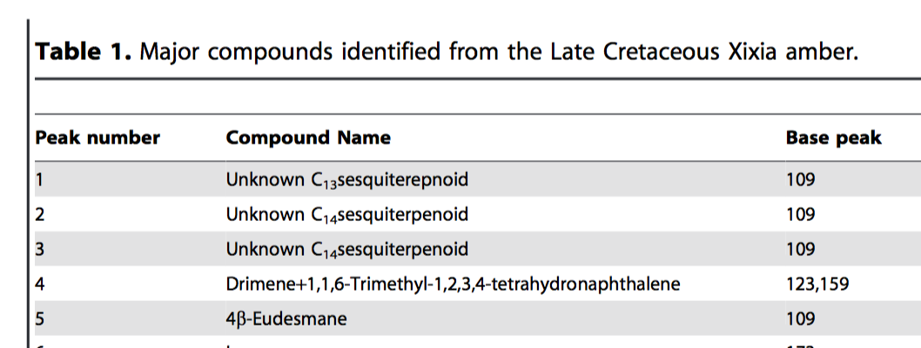
What is “Content”?
TEXT
CHEMISTRY
MATH
SECTIONS
contentmine.org tackles these
TABLES
MAPS
http://www.plosone.org/article/fetchObject.action?uri=info:doi/10.1371/journal.pone.0111303&representation=PDF CC-BY

Slide 9
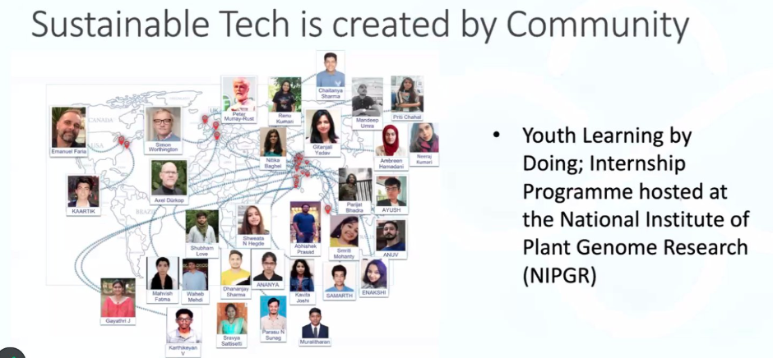
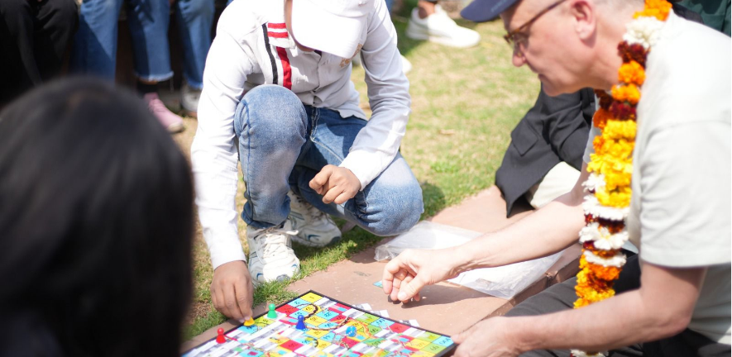
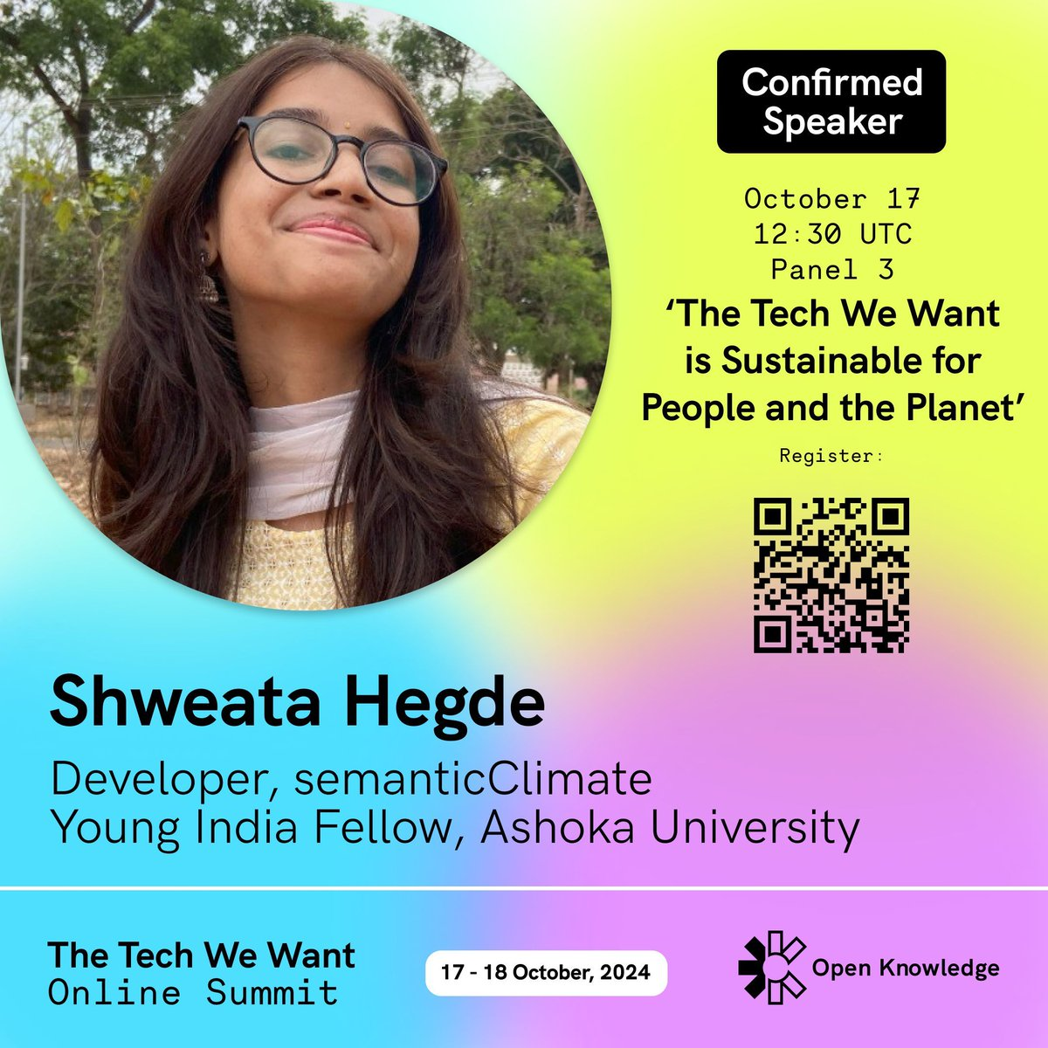
semanticClimate
Builds a community
Automatically collects scientific information , makes it semantic, annotates it:
for learning, re-use and advocacy by everyone

Slide 10
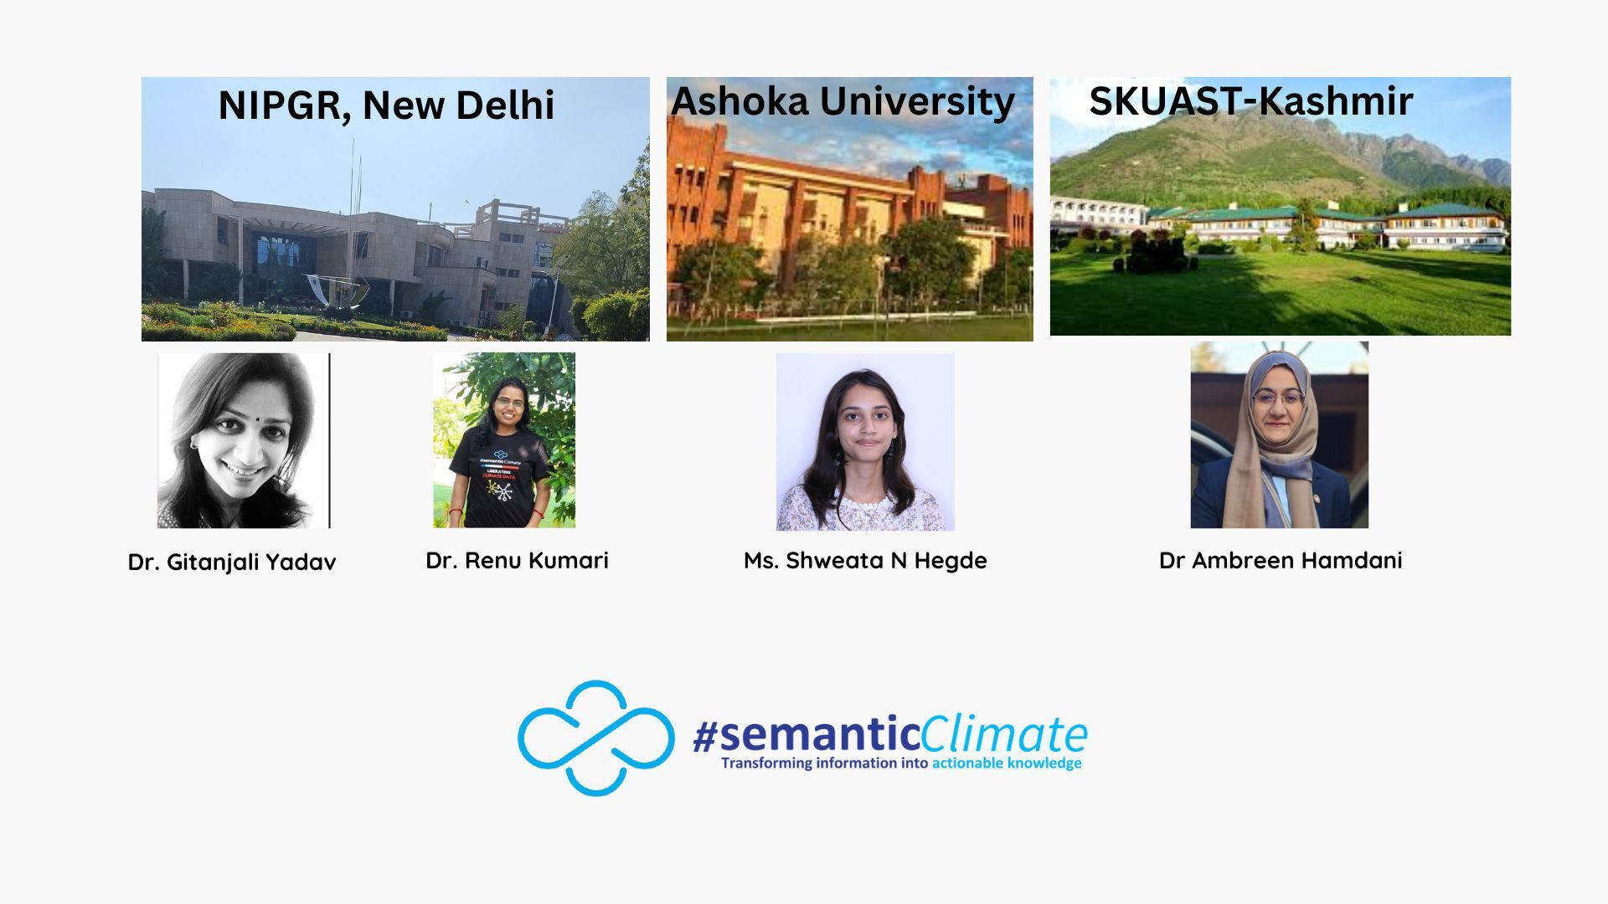
Mentors and Support 2025
“Doctor WHO
handover”
Simon Worthington: TIB Hanover (German National Library of Science and Technology:
Leibniz Information Centre for Science and Technology and University Library)
100+ participants
6-monthly internships (thanks NIPGR)

Slide 11
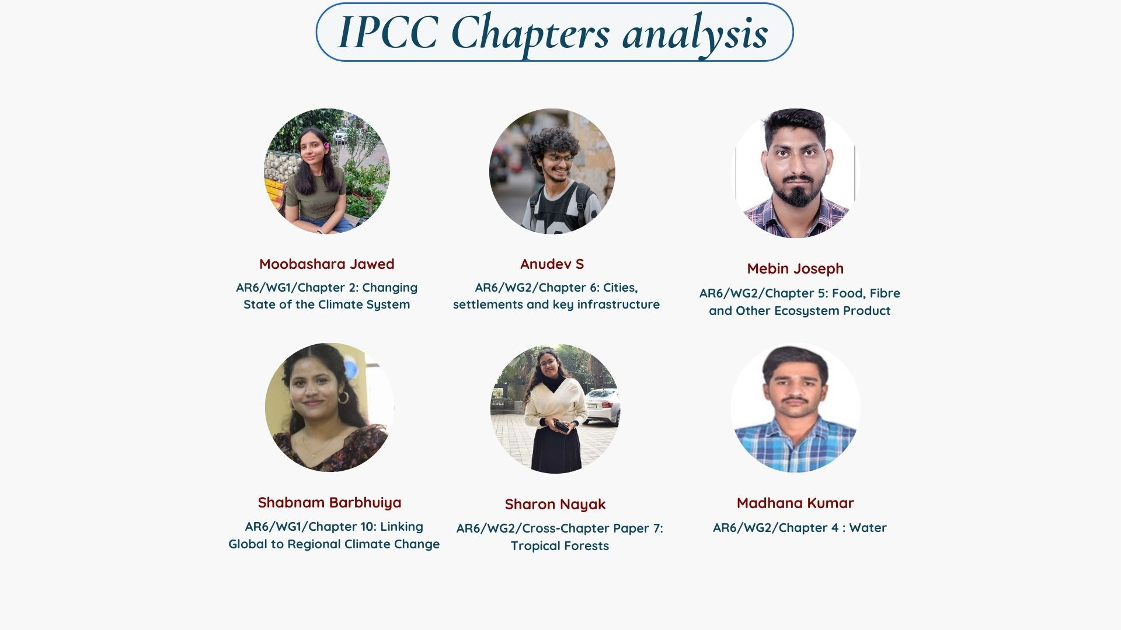
January 2026, no previous experience
Learning by Doing
AMI
Driven by public presentations

Slide 12
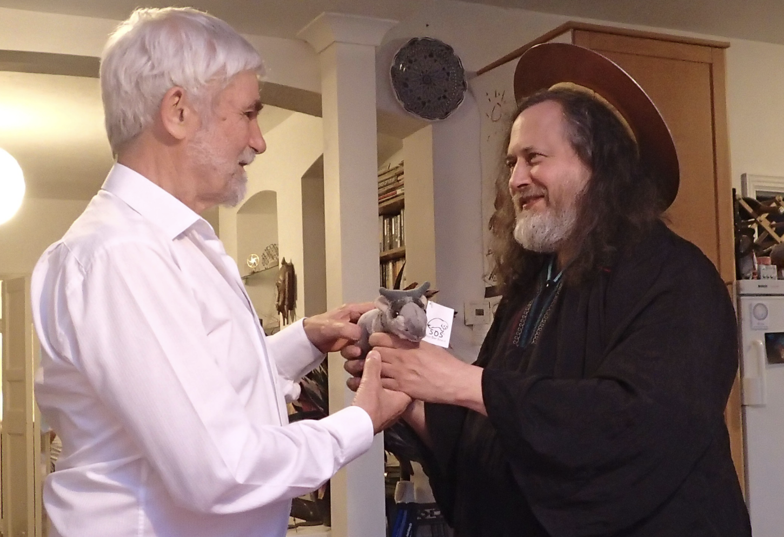
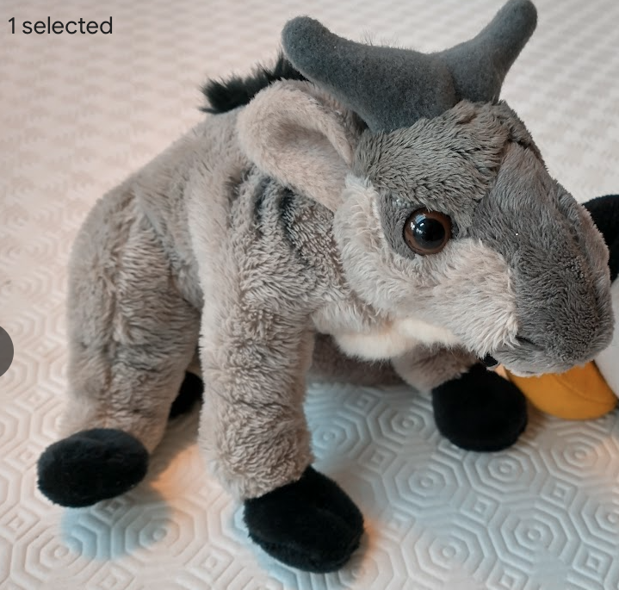
Software freedoms
0. to run the program for any purpose
1. to study how the program works (source code )
2. to redistribute copies so you can help your neighbor.
3. To distribute copies of your modified versions
https://en.wikipedia.org/wiki/The_Free_Software_Definition
GNU
https://blogs.ch.cam.ac.uk/pmr/2014/07/01/visit-of-richard-stallman-rms-to-cambridge/

Slide 13
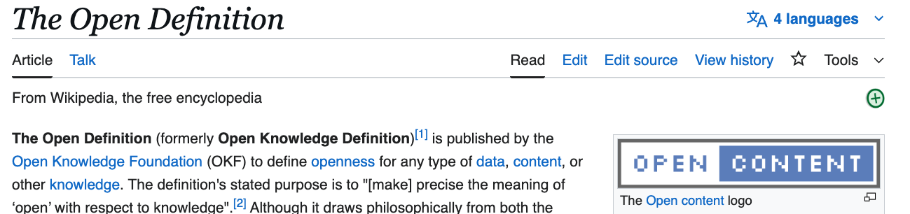
PMR’s requirements
1. to read the content with eyes and machines
2. to redistribute copies to help your neighbour.
3. To distribute copies and aggregates of modified versions
4. To extract and compute any content

Slide 14
Our mission
To create verifiable computable climate* knowledge
we take the following as verifiable sources of truth
IPCC framework (PDF or web-HTML)
UNFCCC reports (COPs)
1000/week scholarly climate publications
* Or any other science

Slide 15
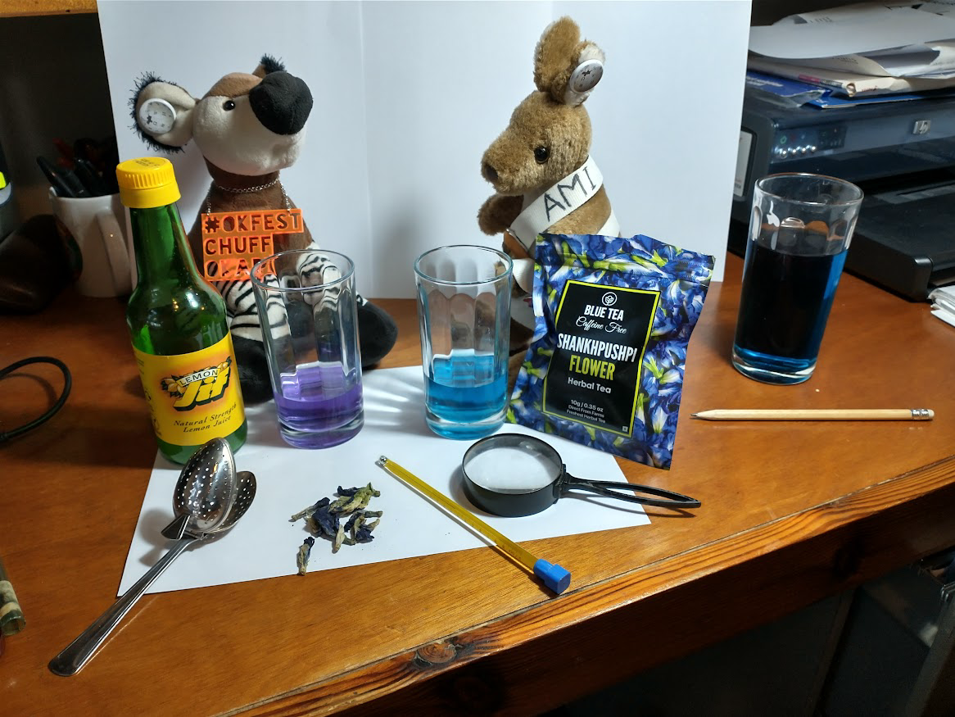
Semantic Science with Wikidata IDs
borosilicate glass
(Q1422588)
water (Q283)
lemon juice (Q1375049)
magnifying glass (Q166849)
thermometer (Q646)
Shankhpushpi
Ayurvedic medicine. (Q37632633)

Slide 16
Knowledge Graphs
our approach is very simple
no OWL, no Protege
RDF triple
node-edge-node
Wikidata!
It’s an enhanced triple Store

Slide 17
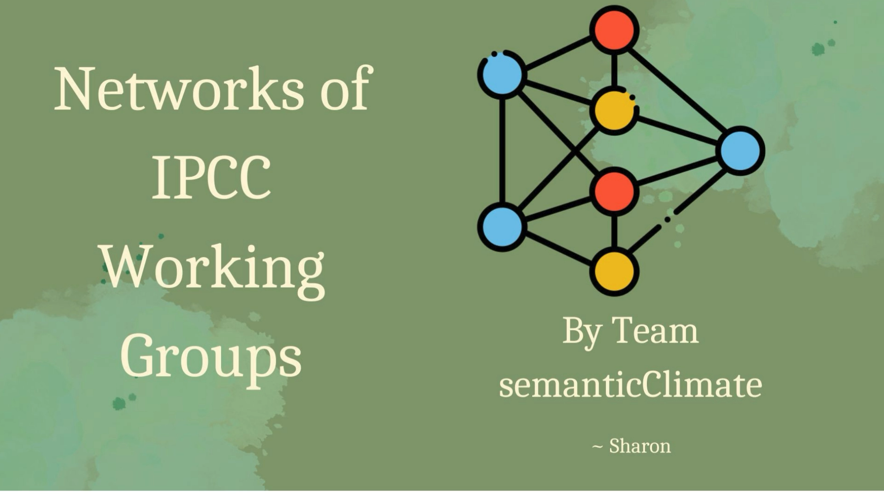
Graph Visualization and Analysis
We’ve many tools...
editors and display
networkX
D3
query languages…
SPARQL
GraphQL

Slide 18

Linked OpenData
100 million items
Dictionaries
Documents

Slide 19
Multi-ontology object markup
How could ontologies be used in ML contexts?
In a Diels-Alder reaction^{RXNO:0000006} described by Sun et al., the specified reactants^{RXNO:0000424}, 36 mmol^{UO:0000040} of 1,3-butadiene^{CHEBI:39478} condensed^{PATO:0001485} at -17.0 °C^{UO:0000027} and 30.0 mmol^{UO:0000040} of maleic anhydride^{CHEBI:474859}, were heated in a container^{OBI:0000967} made of poly-(tetrafluoroethylene)^{CHEBI:53251} with a volume^{PATO:0000918} of 20.0 cm^{3 UO:0000097} to a temperature^{PATO:0000146} of 30.0 °C^{UO:0000027} for the duration of 2 hours^{UO:0000032} and finally cooled to 0 °C^{UO:0000027} in an ice bath. With this setup the objective to produce^{RXNO:0000423} 1,2,3,6-Tetrahydrophthalic anhydride^{PUBCHEM:CID6810} was achieved with a percentage yield^{CHMO:0002855} of 95.6. The commercially available reagents were purchased from the manufacturers^{OBI:0000835} Wako Pure Chemical Industries Ltd. or Tokyo Chemical Industries Co., Ltd.
from Philip Stroemert @TiB.eu

Slide 20
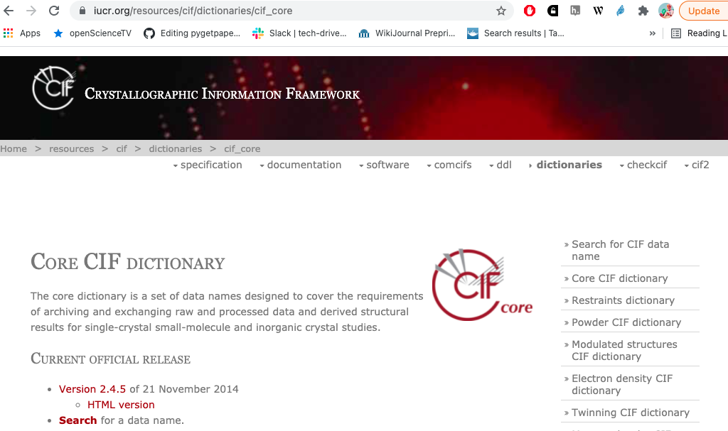
CIF: crystallographic ontology – a model beyond formats
In the late [1970s] the IUCr Commissions […] promoted the development of the Standard Crystallographic File Structure
“Framework” (model) , not “file”
[late 1980s] IUCr promoted the submission of data
in machine-readable form
30 years !
Hall SR, Allen FH, Brown ID (1991). "The Crystallographic Information File (CIF):
a new standard archive file for crystallography". Acta Crystallographica Section A. 47 (6):
655–685. doi:10.1107/S010876739101067X.

Slide 21
Renu’s go-to page of sC Resources https://semanticclimate.github.io/p/en/posts/resources/
Glossary/Encyclopedia (700-2000 IPCC terms) (SimonWorthington)
Knowledge Graph of the IPCC glossary (ShweataHegde)
Wikidata Knowledge Graph of a section of SYR (IPCC Synthesis) (Egon Willighagen)

Slide 22
OUTREACH Past events Shweata and Parijat Bhadra at “The Tech we want” 2024 ISOSC CODATA 2023 many short videos Renu’s page of videos Upcoming event OKFN ORDEM (Shweata and Ambreen) Feb 15 2025 we'd love to Scale up knowledge graphs Find new users make our terminology available find new volunteers (climate, IT, languages) Build tested libraries Have a look at our resources!

Slide 23
Thanks to: * Yusuf Hamied Travel Fellowship (Cambridge India)
NIPGR Hosting and internships
Indian National Young Academy of Scientists
Egon Willighagen
Wikimedia
The brave people who have challenged injustice

Slide 24
Presentations from OKF “TheTechWeWant 2024”
Shweata and Parijat describe IPCC; how to make it semantic
Enshittification alert! There may be YouTube ads
https://www.youtube.com/watch?v=o50Jd1w6xKw&t=16842s&ab_channel=OpenKnowledgeFoundation (Shweata N Hegde)
https://www.youtube.com/watch?v=V7Sxo0IXe8g&t=7800s&ab_channel=OpenKnowledgeFoundation (Parijat Bhadra)

Slide 25
End of Presentation
(some random pages about AI follow)

Slide 26
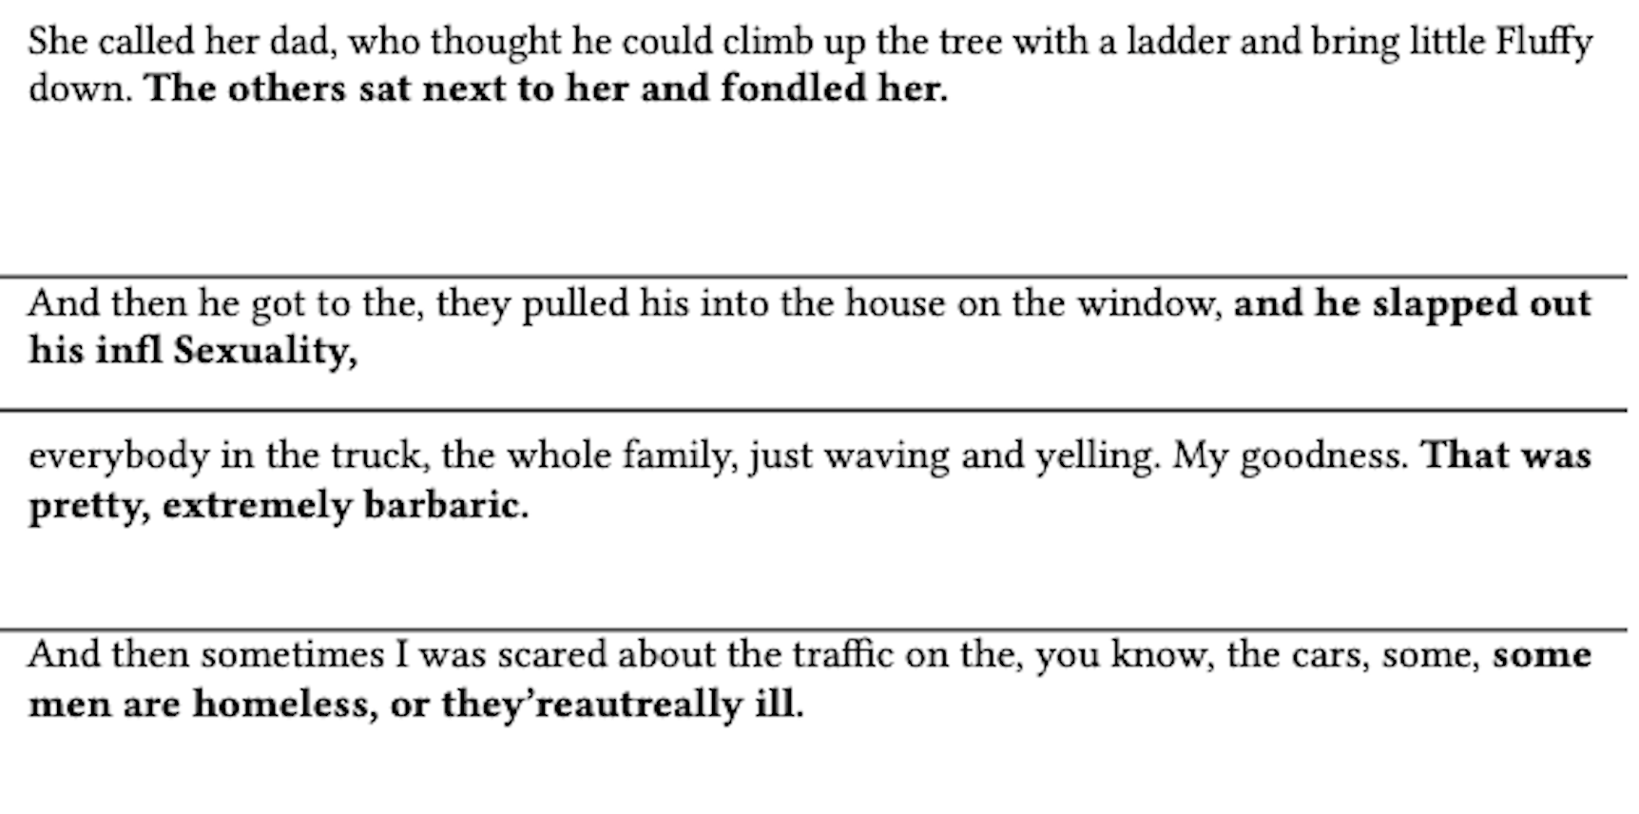
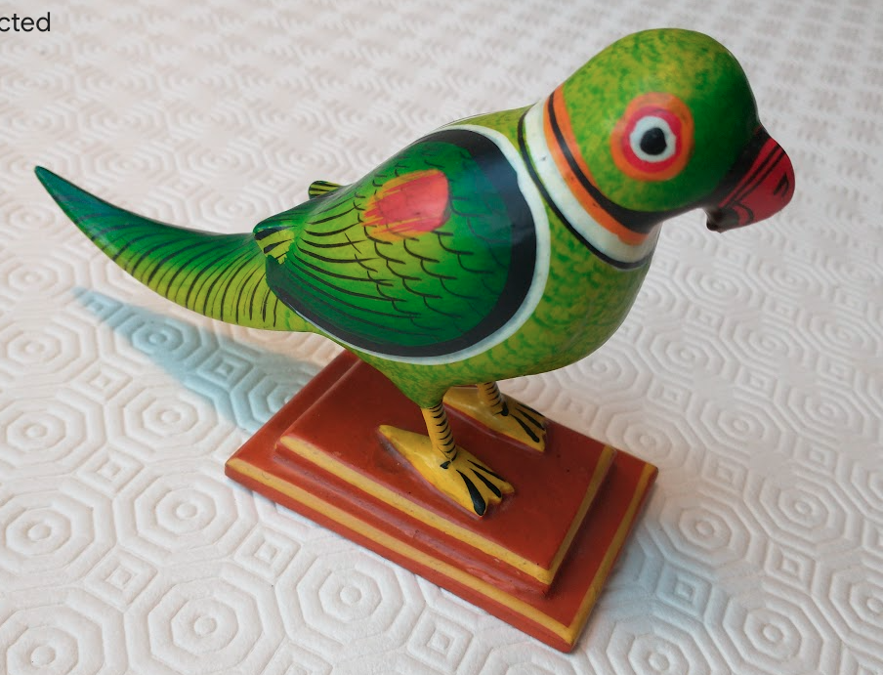
Hallucinations!
Polly,
stochasticParrot

Slide 27
Should we trust HuggingFace?
I don’t know where their data comes from
And they don’t have an advisory board
AMI, semanticClimate
We must create our own OKF-Open framework!

Slide 28
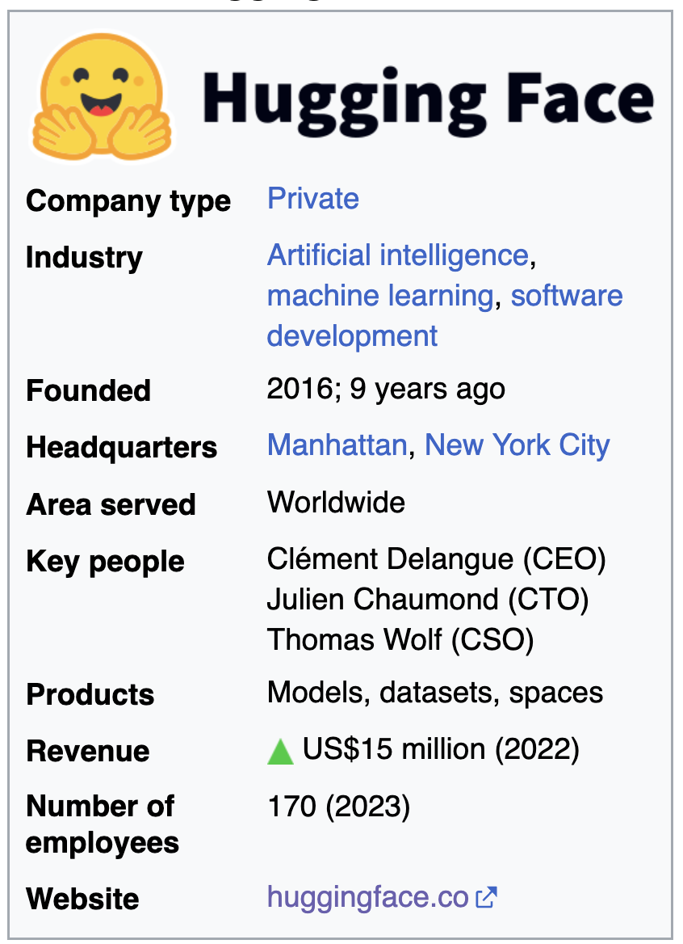
the data are private,
run by a private for-profit company
“We are on a mission to democratize good machine learning, one commit at a time.”

Slide 29
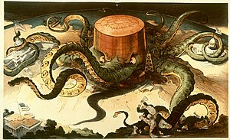
ROBBER BARONS
1904 depiction of an acquisitive and manipulative Standard Oil (founded by John D. Rockefeller) as an all-powerful octopus
Those practices included
unfettered consumption and destruction of natural resources,
influencing high levels of government,
wage slavery,
squashing competition by acquiring their competitors to create
monopolies and/or trusts that control the market, and
* schemes to sell stock at inflated prices to unsuspecting investors.^{[2]}
Credit: Wikipedia

Slide 30
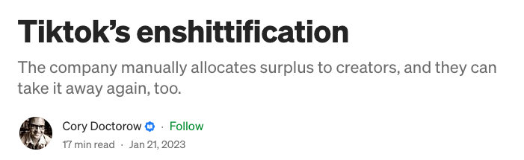
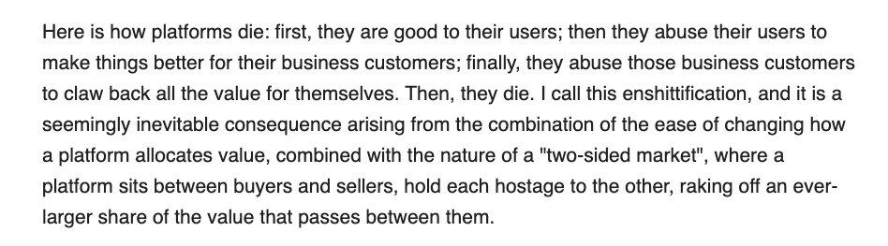
https://pluralistic.net/2023/01/21/potemkin-ai/#hey-guys

Slide 31
Engage your brain! Control AI or it will control you!
AMI, semanticClimate

Slide 32
https://x.com/okfn_okapi

